Slide 1










ONLINE HOTEL MANAGEMENT SYSTEM

Slide 2
ABSTRACT
This project aims at creating an Online Hotel Management system which can be used by customers to reserve hotel rooms.
Users can check the availability of rooms and facilities.
The users can register and log into the system.
The administrator will know the details of reservations and daily income.

Slide 3
EXISTING SYSTEM
In the existing system, the person who wants to book a room has to visit the hotel for booking hotel rooms, and enquiry.
The existing system is manual system.
The hotel management has to keep records of rooms manually.

Slide 4
DISADVANTAGES OF EXISTING SYSTEM
It is a time consuming process.
There is no surety of availability of rooms.
Paper work results in need of lot of space to keep the data.
Lack of security.
Chances of human errors.

Slide 5
PROPOSED SYSTEM
To overcome the problems of manual system, online hotel management system is proposed.
The Central objective of Online Hotel Management is to provide online facility for booking rooms.
This software can manage and keep records of hotel.

Slide 6
ADVANTAGES OF PROPOSED SYSTEM
Saves time of customers in quickly reserving rooms.
The ability to book rooms anytime, from anywhere with Internet access.
Provides the information about hotel facilities.
very secure.
User friendly.

Slide 7
SYSTEM ANALYSIS
This project is used by two types of users (modules).
Online Users
Administrator (management of the Hotel)

Slide 8
USER MODULE
Check room availability.
Fill registration form.
Can login with his/her own user id and password.
Get facilities of hotel like restaurant.
Get the information about nearby visiting places.
Get information about reserved rooms (if room is already reserved).
Can regenerate password if he/she forgets the password.

Slide 9
ADMINISTRATOR MODULE
Can login with unique user id and password.
Check details of rooms reserved for the current day.
Check details of rooms reserved for the coming days.
Can know the daily income.

Slide 10
DESIGN CONSTRAINTS
SOFTWARE CONSTRAINTS
OPERATING SYSTEM – WINDOWS/LINUX
DATABASE – MYSQL
PLATFORM – PHP
WEB SERVER – XAMPP
HARDWARE CONSTRAINTS
PROCESSOR – INTEL CORE i3(2.30 GHz)
RAM – 1 GB RAM
HARD DISK – 250 GB HDD
LCD MONITOR

Slide 11


UML DIAGRAMS
THE UNIFIED MODELING LANGUAGE (UML) IS A
FOR
THE ARTIFACTS OF SOFTWARE SYSTEMS, AS WELL AS FOR BUSINESS MODELING AND OTHER NON-SOFTWARE SYSTEMS
THE UML USES GRAPHICAL NOTATIONS TO EXPRESS THE DESIGN
OF SOFTWARE PROJECTS
STANDARD LANGUAGE
SPECIFYING, VISUALIZING, CONSTRUCTING, AND DOCUMENTING

Slide 12
Use Case Diagram for User:-
Register
Login
Check availability
reserve room
User
Display room details
Cancel rooms
Wallet
Logout

Slide 13
Sequence Diagram for User:-
Register
login
Check availability
Reserve room
Display room details
Cancel
Logout
: User
1 : Register()
2 : Login with username and password()
: Invalid username and password()
4 : Check the availability of rooms() 5 : list of rooms available()
6 : reserve a room()
3
7 : Display the details about reservation()
8 : Cancellation of room()
9 : Log out()

Slide 14


Activity Diagram for User:-
Login
Verification of username and password
Invalid username and password
Display reserved room details
check availability
Cancel room
reserve room
Display details
logout

Slide 15
Usecase Diagram for Administrator:-
Login
Display Information
Administrator
Log out

Slide 16
Sequence Diagram for Administrator:-
Login
Display
: Administrator
1 : Enter Username and password()
2 : Validate()
3 : Invalid Username()
4 : Display reserved rooms for the current day()
5 : Display rooms reserved for the coming days()
6 : Logout()

Slide 17


Activity diagram for Administrator:-
Login
Verification of username and password
no
Invalid username and password
yes
display the reserved room details
logout

Slide 18
Class diagram for the System:-
User
-Username: string -Password: string -ID: integer -Emailid:string -MobileNo:string -AadharcardNo:long
+register() +login() +check_availability() +reserve_room() +cancel_room() +logout()
administrator
+Username: String +Password: string
+Login() +Display() +Logout()
1
1..*

Slide 19
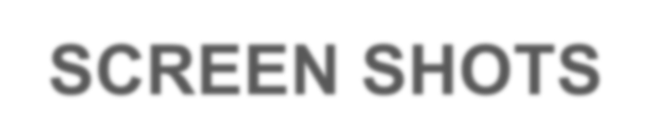

Slide 20
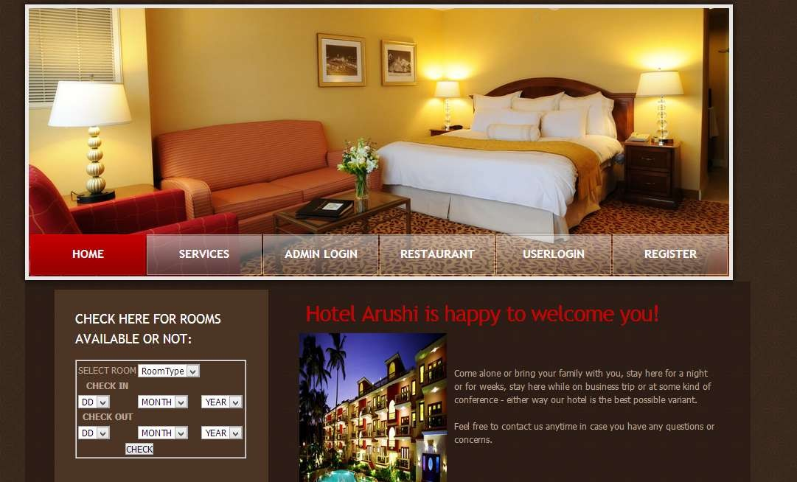
This is the home page.

Slide 21
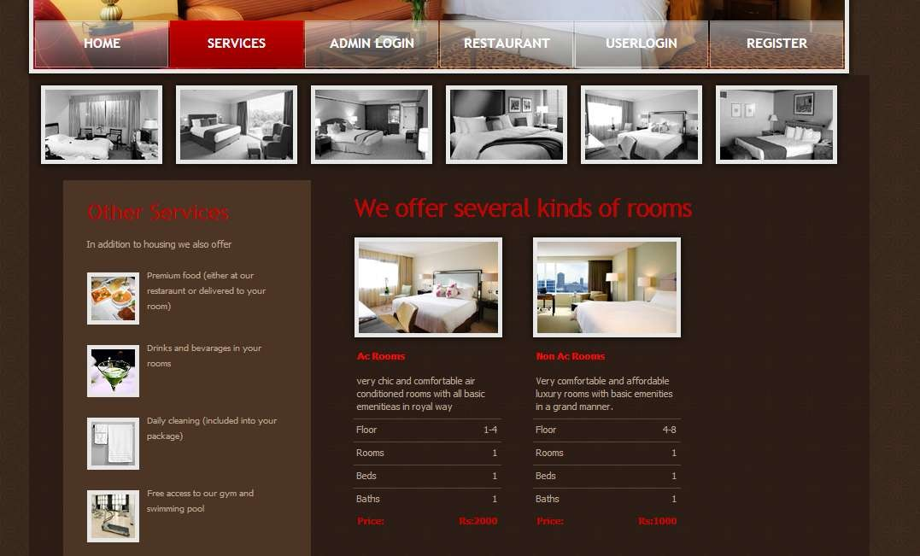
This page displays the services provided by the hotel.

Slide 22
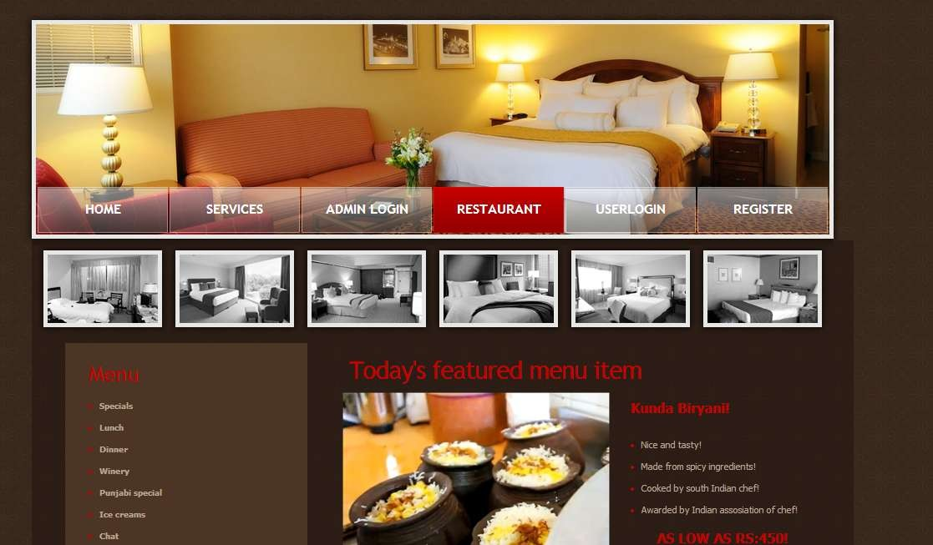
This page displays the information about restaurant.

Slide 23
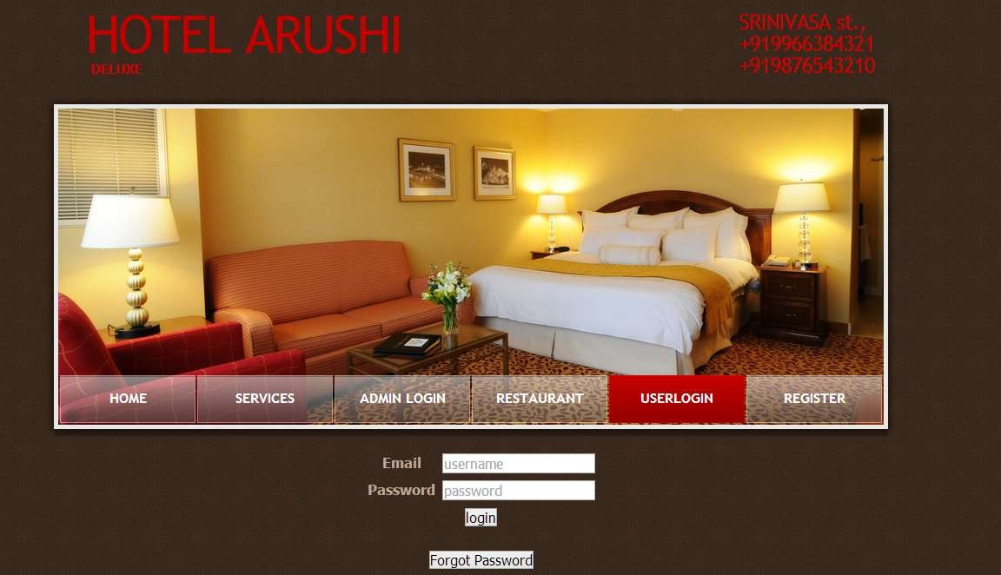
This is user login page.

Slide 24
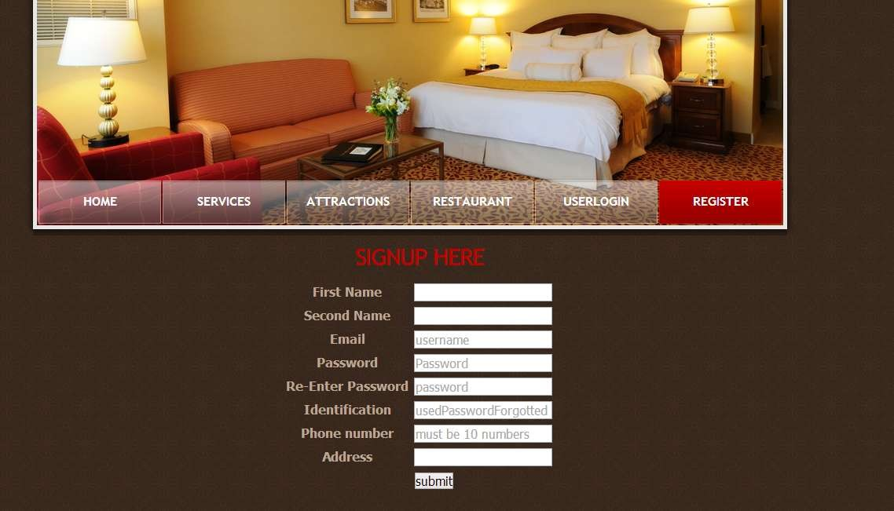
This is user registration page

Slide 25
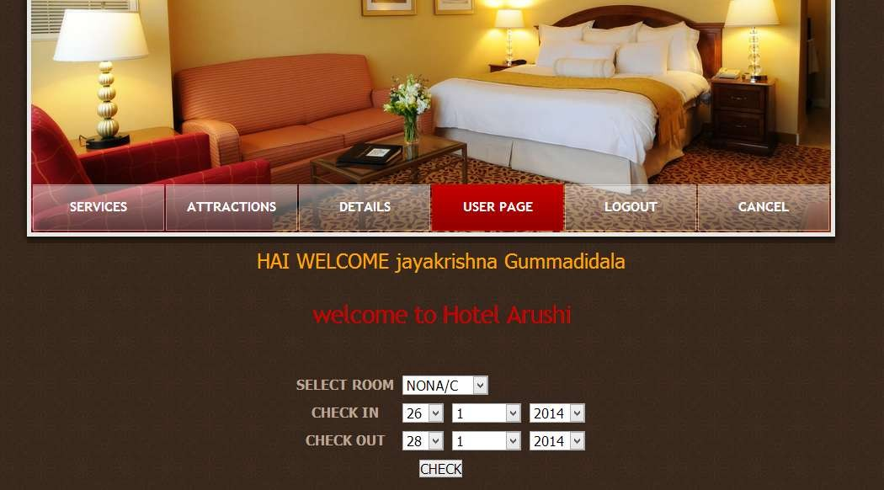
After user log into the system, user can specify the check in,
check out dates and room type.

Slide 26
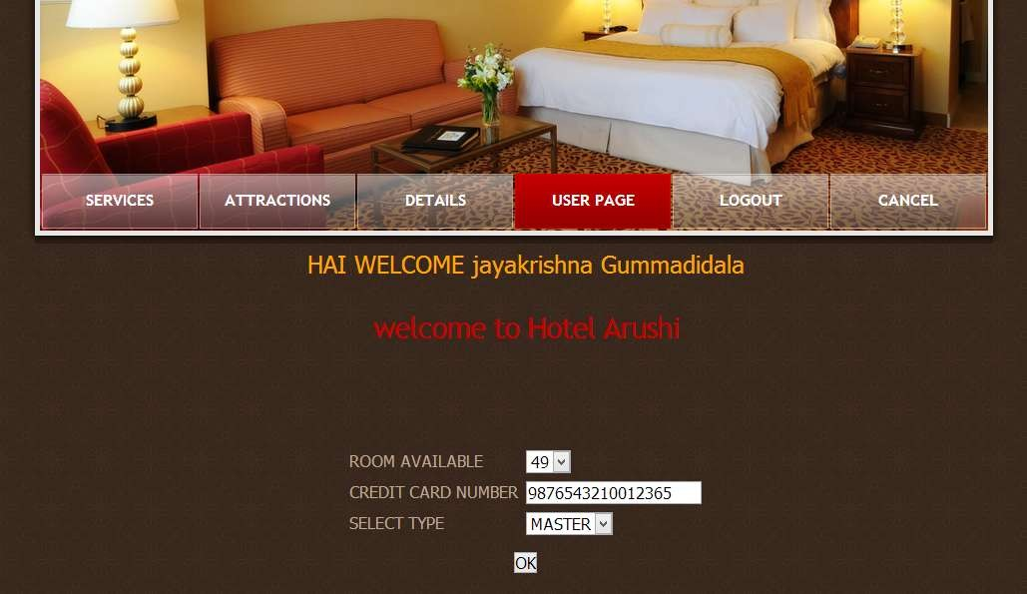
The available rooms are selected, credit card details are given.

Slide 27
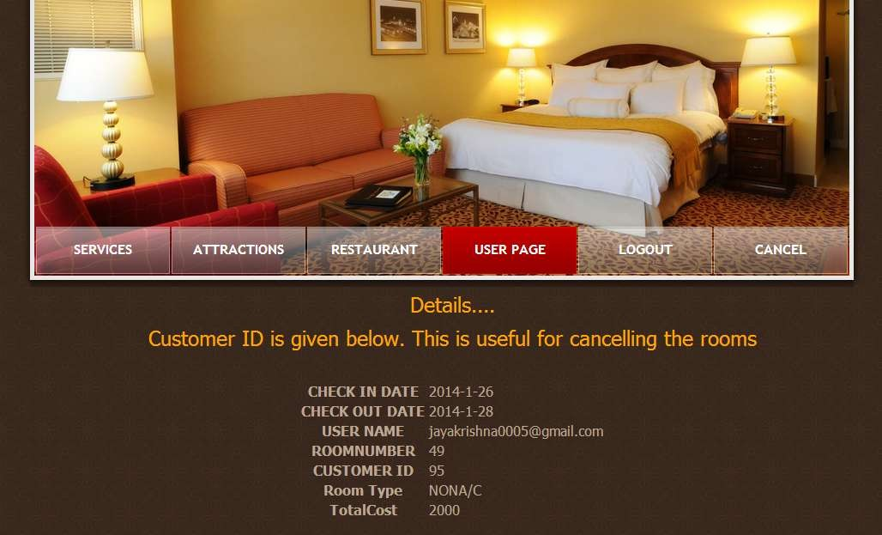
After reserving the room, customer details are displayed.

Slide 28
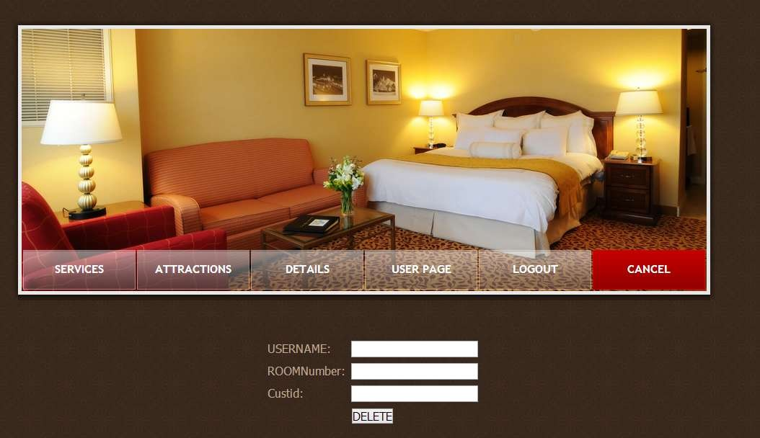
User can cancel the reserved room by using the customer ID.

Slide 29
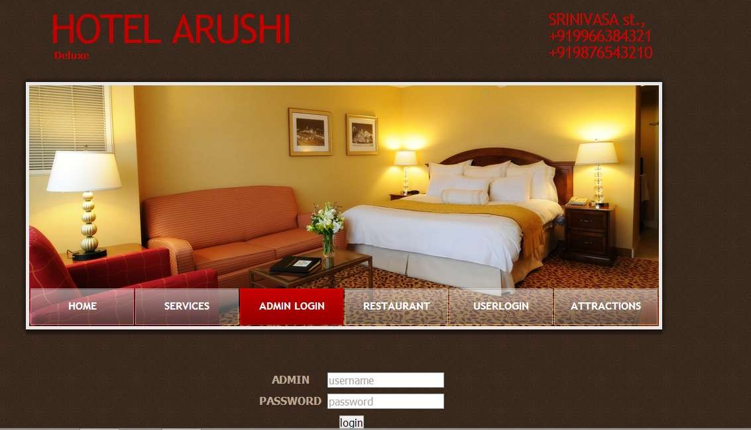
This is administrator login page.

Slide 30
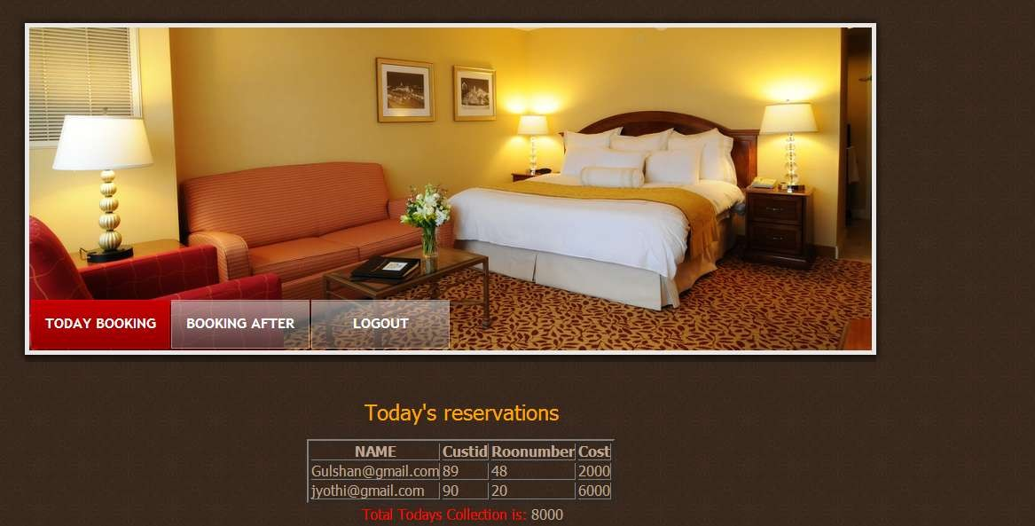
Displays the details of rooms reserved for the current day.

Slide 31
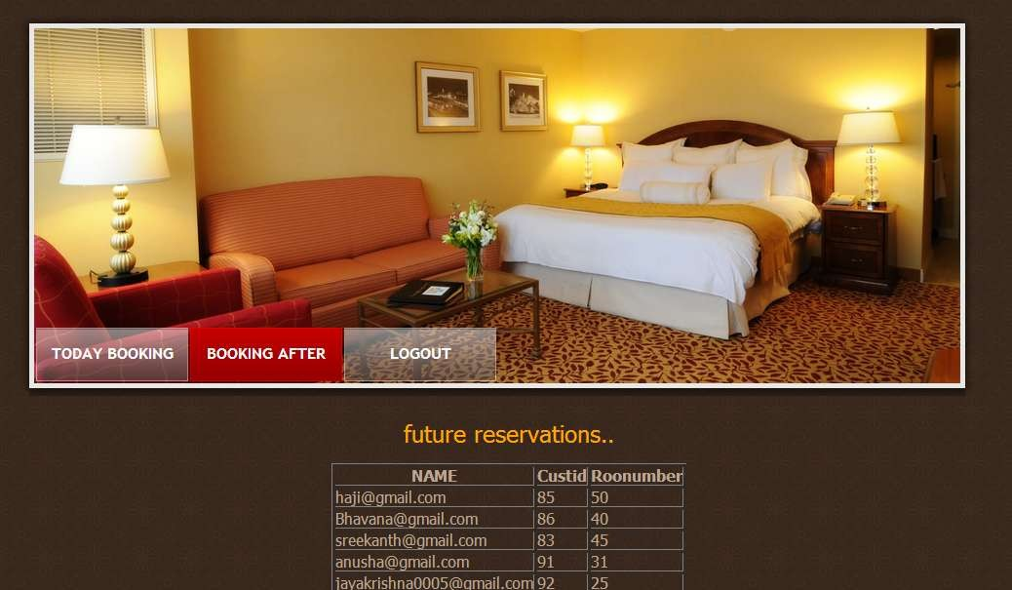
Displays the details of the rooms reserved for the coming days.

Slide 32








THANK YOU
SEE YOU AGAIN

